Slide 1
Statistical Methods for Genomics Part 1: GWAS

Slide 2
Outline
Background in Molecular Genetics and basic genetic models
Genome-wide association studies

Slide 3
Goal
The most important problem in human genetics is that of gene mapping: the process of identifying the location of disease causing variants in the human genome

Slide 4
Human Genetics
Most of early studies: plant and animal genetics – Mendel’s experiments with garden peas in 1860’s
Human genetics in particular is fairly young discipline.
Humans are difficult to study because:
- experimental crossings are not possible
- environmental factors are hard to control
- humans have small families with many years needed for a new generation to develop

Slide 5
Brief History
In the beginning, there was no standardized way to assay the genetic information at the molecular level in an individual
Traits or phenotypes
For example, a person’s blood type at the ABO locus is a phenotype that depends on the variants at the ABO gene.
Familial aggregation: whether traits or diseases were inherited
Familial aggregation provides the justification for molecular studies.

Slide 6
From aggregation studies to genetic studies
Technology development: determine genetic information at specific genetic markers in the genome in an efficient and high-throughput way
Four major international projects:
Human Genome Project (1990-2003): the primary objective of the project was to identify all of the genes in the human genome and identify the sequence of all 3 billion DNA base pairs in one individual.
HapMap Project (2002-2006) http://hapmap.ncbi.nlm.nih.gov/ – genotyped a million SNPs in 269 individuals – genotyping arrays - GWAS
1000 Genomes Project (2008-) http://www.1000genomes.org/ – Sequencing studies and Rare Variants.
ENCODE Project – functionally annotate the variation in the human genome

Slide 7
Examples of genetic diseases
Mendelian diseases are inherited diseases that follow a simple pattern of inheritance, like dominant, recessive and are usually caused by genetic defects at one major gene. They are rare and severe conditions, like Cystic Fibrosis, Duchenes’ Muscular Dystrophy, and Sickle Cell Anemia.
Many common diseases are complex, being caused by many genetic and environmental factors.

Slide 8
Genetic Variants
Genetic variants are key for the process of gene mapping
Mutations are constantly introduced in the genome, and they give rise to genetic variants
Many genetic variants have no effect on disease.
SNP (single nucleotide polymorphism): occur commonly throughout the genome, and are cost effective to genotype in large numbers (millions) in GWAS
E.g. a biallelic locus (SNP) has two possible alleles: B and b.
Let frequency of allele ‘B’ be p and that of ‘b’ be q=1-p. Let’s say q<=0.5
‘b’ is called minor allele, and ‘B’ major allele
Genotype: the pair of alleles in an individual: homozygous (BB, bb), and heterozygous (Bb).
Recent explosive human population growth: from a few million people 10,000 years ago to over 7 billion today generates lots of rare variants that can play a role in disease

Slide 9
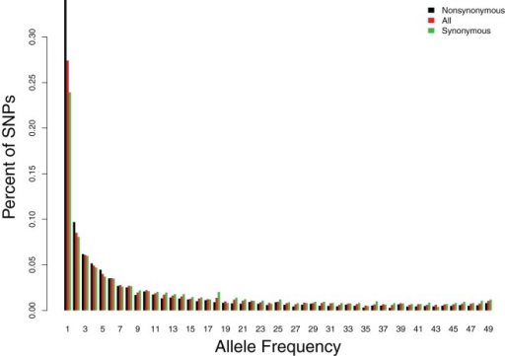
Site Frequency Spectrum

Slide 10
Early Genetic Mapping Efforts
Linkage analysis is an early statistical method to identify disease genes. Linkage uses marker data on individuals in families/pedigrees: study patterns of co-inheritance of the marker and the disease throughout the pedigree.
Linkage has been successful for Cystic fibrosis, Huntington’s disease (Mendelian diseases)
Rare variants underlying early onset of Alzheimer’s disease
Linkage analysis has been less successful for complex traits, mostly due to reduced power for identifying variants of low effect, and reduced segregation of disease and any particular marker.

Slide 11
Association testing
Similar to statistical tests of association in categorical data analysis

Slide 12
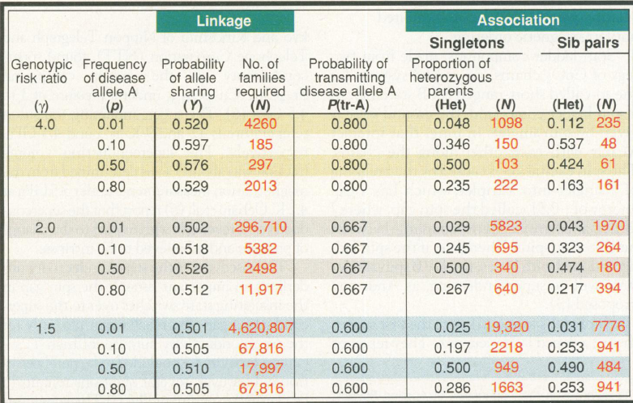

Slide 13
Genetic Models
A genetic model describes the relationship (usually probabilistic) between an individual’s genotype and their phenotype or trait Y.
P(Y|G)=penetrance function
Dominant: P(Y|DD)=P(Y|Dd)
Recessive if two copies of disease allele are needed to increase risk
Additive if the penetrance of the heterozygous genotype is midway between the two homozygous
The codominant model is the most general, and makes no assumption on the three penetrances
Genetic model: rarely known in practice

Slide 14
Types of association tests
We are interested in testing for association between a SNP and a trait of interest
SNP: categorical variable with three genotypes
Degree of freedom (DF):
-2-DF that compare all three genotypes
-1-DF : some assumption (monotonicity) about disease risk and genotype
- very popular as they tend to be more powerful

Slide 15
2DF: Association Testing (Co-dominant)
 | aa | Aa | AA | Total
Cases | r0 | r1 | r2 | r
Controls | s0 | s1 | s2 | s
Total | n0 | n1 | n2 | n
This is the most general test, when nothing is assumed about the relationship between disease and genotype
The co-dominant test:
H0: P(Y=1|AA)=P(Y=1|Aa)=P(Y=1|aa)
H1: At least one inequality holds
1 DF tests are more popular: they correspond to Mendelian disease models: recessive or dominant, or assume an additive model

Slide 16
1DF: Recessive and Dominant Tests
 | aa | Aa or AA | Total
Cases | r0 | r1+r2 | r
Controls | s0 | s1+s2 | s
Total | n0 | N1+n2 | n
Dominant model:
H0: P(Y=1|AA)=P(Y=1|Aa)=P(Y=1|aa)
H1: P(Y=1| at least one A allele)!=P(Y=1|aa)
Optimal when the true disease model is dominant but not for recessive (HA: P(Y=1|AA)!=P(Y=1|at least one ‘a’ allele))

Slide 17
Cochran-Armitage Trend Test
Test of additive mode of inheritance
X=additive coding for genotypes
Y=1, 0
P(Y=1|X)=b0+b1X
Ordinary regression to estimate b1 and test
H0: b1=0

Slide 18
Regression approach: extension to covariate adjustment and to other phenotypes
Generalized linear models (GLMs)
For measured outcomes:
E(Y|X)=b0+b1X
Test H0: b1=0
Easy to adjust for covariates

Slide 19
GWAS

Slide 20
Genome-wide association studies (GWAS)
Scan the entire human genome at hundreds of thousands or millions of markers.
Many robust associations with complex diseases.

Slide 21
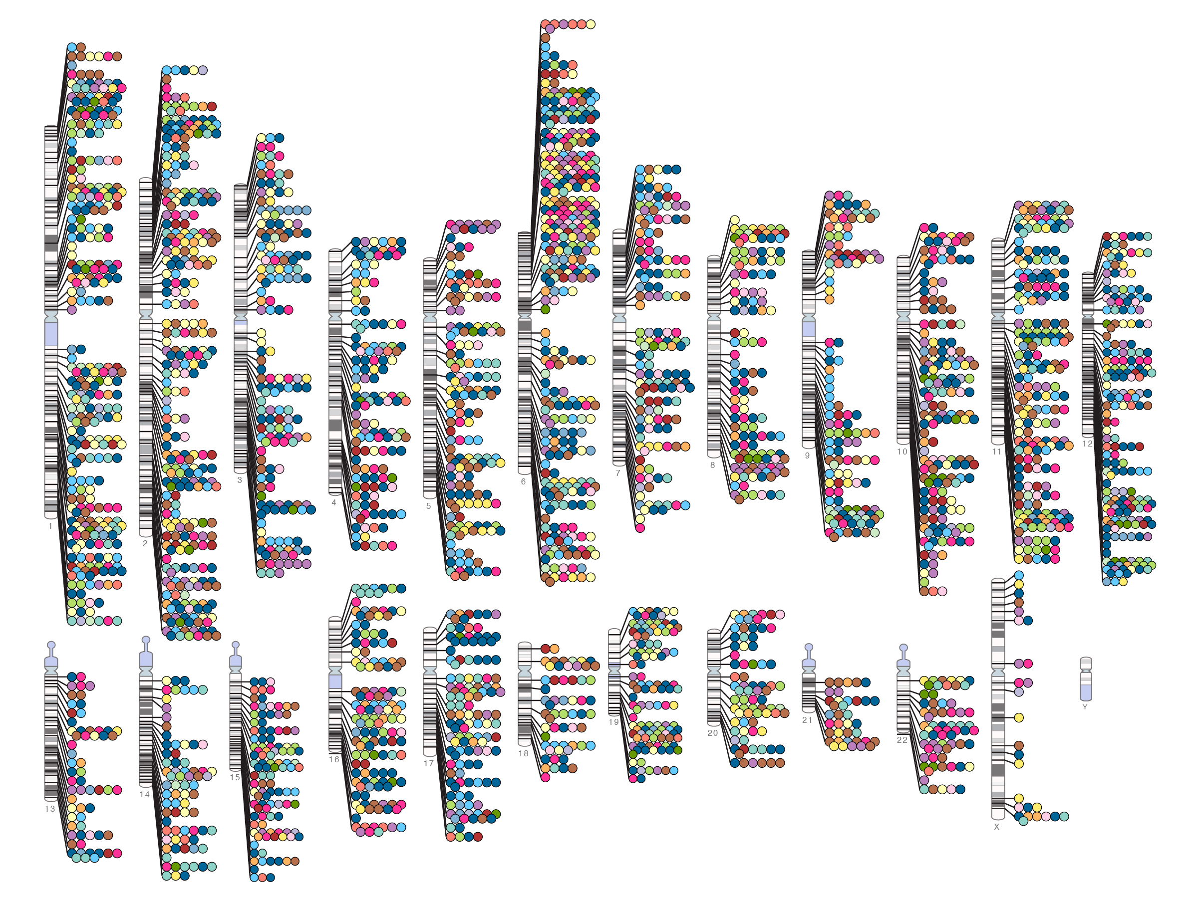
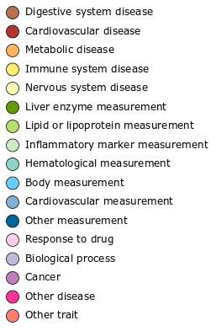

Published Genome-Wide Associations through 12/2012
Published GWA at p≤5X10⁻⁸ for 17 trait categories
NHGRI GWA Catalog
www.genome.gov/GWAStudies
www.ebi.ac.uk/fgpt/gwas/

Slide 22
QC (quality-control) Analysis
Quality control is a compulsory part of any statistical analysis.
Quality of DNA: blood vs. bucal swab
Handling and storage of sample
Genotyping platforms
If genotyping error occurs completely at random then reduced statistical power but no bias in the alpha-level of the test
Non-random genotype errors can lead to highly inflated false-positive rates
For example, if cases and controls are genotyped at different times, different laboratories, different technologies, etc..
Beware of convenience controls!

Slide 23
Study Designs
Population-based
Family-based

Slide 24
Multiple Testing
Millions of markers
Need to adjust the alpha level to very stringent values to correct for multiple testing – leads to loss of power.
Bonferroni Correction: alpha=0.05/M
For GWAS with 1 million SNPs: alpha=5x10^-8
Bonferroni can be very conservative, especially when markers are correlated.
Other possibilities: control the FDR (false discovery rate).

Slide 25
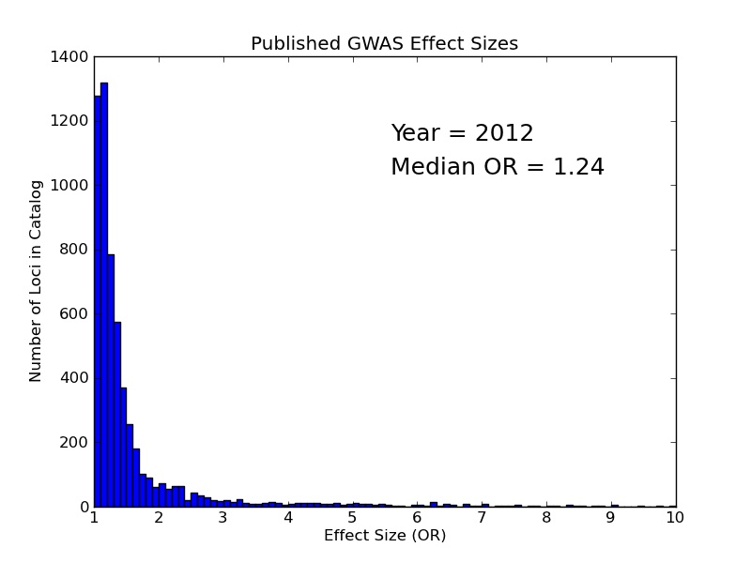
Modest effect sizes

Slide 26
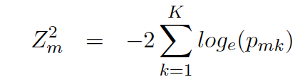
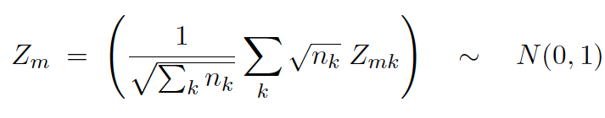
Meta-analysis
Because results from independent samples are likely to vary, usually results are combined in a meta-analysis
Different types of methods: e.g. combine effect sizes, or combine p-values
1. Combine effect sizes: fixed-effect and random-effect models
Fixed-effects meta-analysis: there is only one true effect across studies
Random-effects meta-analysis: effect could vary from study to study
2. Combine p-values:
Fisher’s method: combine P-values using Fisher’s method
This approach does not take into account sample size differences between studies
We would like to give more weight to the larger studies (more precision)
Another approach is to use Z-scores weighted by the sample size (or inverse-variance).
Issue of imputation occurs when combining different studies with different genotyping platforms.

Slide 27
Imputation=In-silico Genotyping
Imputation is the process of predicting a set of genotypes that are not directly assayed in a sample of individuals
Only a subset of SNPs can be genotyped in genome-wide association studies. Imputation methods can infer the alleles of ‘hidden’ variants and use those inferences to test the hidden variants for association.
Imputation has been widely used in GWAS to boost power, fine-map associations and allow combination of results across studies using meta-analysis.

Slide 28
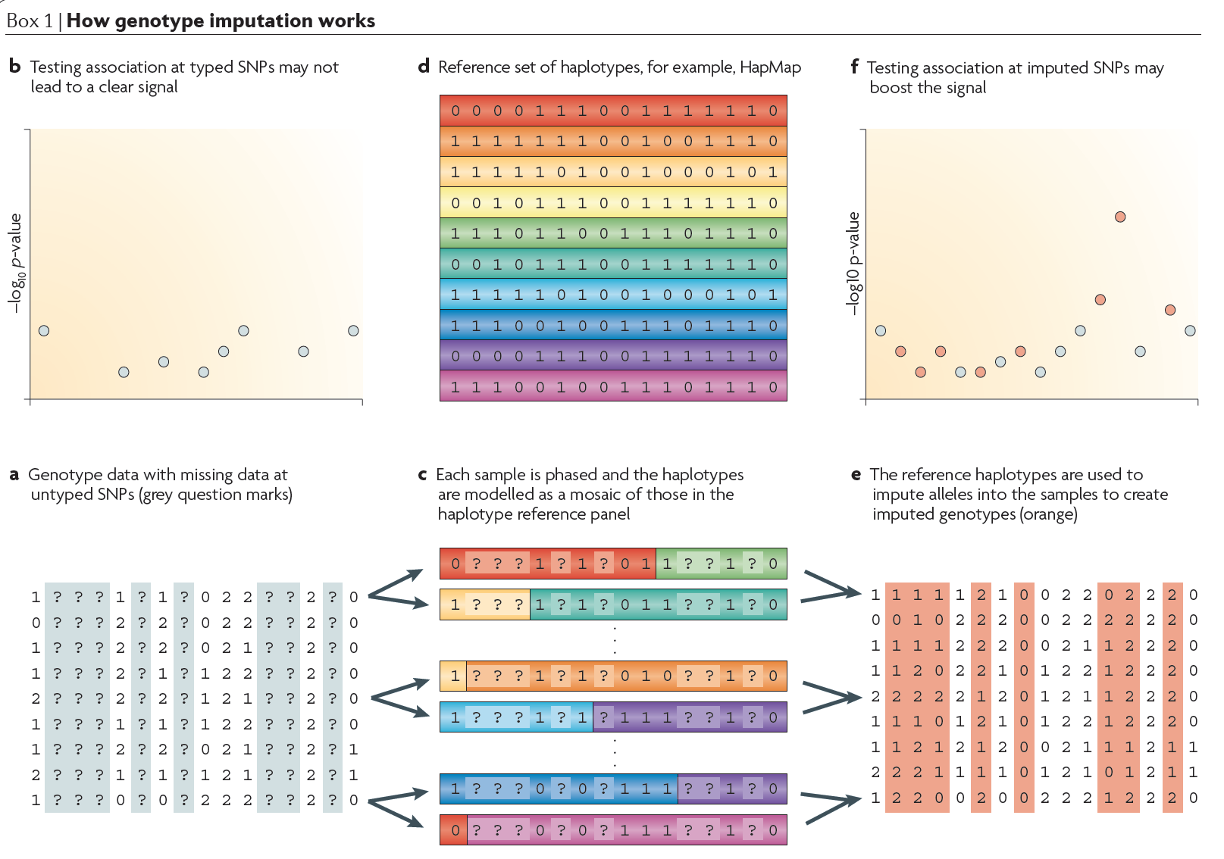

Slide 29
Reference Set
Starting point: reference set of haplotypes
The structure of the linkage disequilibrium in the reference population, in conjunction with the structure of the linkage disequilibrium of the observed SNPs within both the cases and the controls, can be used to impute the alleles of a hidden SNP.
Reference population: haplotypes from HapMap, 1000 Genomes, large datasets from sequencing studies
Hapmap haplotypes: 120 CEU, 120 YRI, 180 JPT+CHB very dense set of markers.
1000 Genomes data: more populations available, sequenced at low coverage, but still difficult to impute the rare variants
Recently: large sequencing study in Iceland, sequencing the whole genomes of 2,636 Icelanders to a median depth of 20× (Gudbjartsson et al. Nature Genetics 2015). This dataset can serve as reference panel to impute low frequency variants in GWAS studies.

Slide 30
Imputation - Methods
Hidden Markov Models (HMMs)
Let H be a set of reference haplotypes. If G_i is the vector of genotypes for individual i, then we can compute:
Where each Z is a pair of haplotypes formed from the reference panel, allowing for recombination (ro) and mutation (theta).
Software tools for imputation: IMPUTE, MACH (similar, but theta and ro are estimated from data), BEAGLE

Slide 31
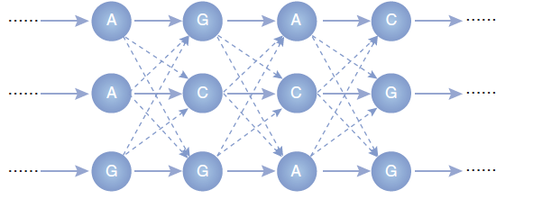
HMM
Each column is a SNP, each row is an ancestral haplotype. Each new haplotype is
generated as a random walk along the Markov chain.
Learn the parameters of this HMM.

Slide 32
Performance of Imputation Methods
Minor allele frequency: common SNPs are more accurately imputed compared with rare SNPs
Reference Panel

Slide 33
Accuracy of imputation
Accuracy is very important as poorly imputed SNPs can lead to false positives
Normally, imputed SNPs that are associated need to be genotyped
Genotypes are imputed with uncertainty and a probability distribution over all three genotypes is produced and used in downstream association analyses, for example by using the expected allele count: P(AA), P(Aa), P(aa)
Quality of the imputed SNP: 1 means complete certainty, 0 means complete uncertainty – filter out low quality imputed SNPs. For example, one measure is the R^2 between the best guess genotype and the allele dosage (expected allele count).

Slide 34
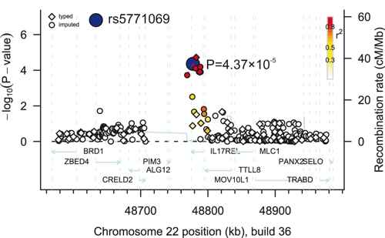

Slide 35
Population substructure in association studies
Population-based designs: unrelated individuals
Easy to recruit, straightforward statistical analysis
Epidemiological studies available for many complex traits, and hence only genotyping is usually required, with no additional recruitment

Slide 36
Problems with population-based genetic studies
Effect sizes (ORs) are small to modest for complex traits. Therefore large sample sizes are required to have sufficient statistical power
Very popular, but also have weaknesses
Association can be due to confounding: population admixture or stratification

Slide 37
Three common types of population substructure
Population stratification: different sub-populations/strata
Population admixture: mixture of different genetic ancestries due to mixing of two or more populations in the past
Population inbreeding: Preference of mating among relatives in a population or because of geographic isolation restricts mating choices

Slide 38
Population Substructure
The estimate of allele frequency can still be unbiased if equal probability sampling from target population
However, the presence of population substructure can mean that not all subjects have the same probability of being selected depending on how selection is done
For example, if genotype frequencies differ between subgroups and sampling favors certain subgroups over others, the sample estimate may be biased
Even if no bias, variance of the estimate can be affected, and can affect the validity of the association test results
Methods to adjust for population stratification by correcting the bias and variance issues

Slide 39
Variance Inflation
Population substructure generates over-dispersion of test statistics used to test for association
Variance inflation factor=ratio of true variance to the expectation of the variance:

Slide 40
Approaches to population stratification
Methods are based on the availability of an additional set of `null’ markers
Genomic Control (Devlin and Roeder 1999)
STRUCTURE (Pritchard 2000)
Eigenstrat (Price et al 2006)
EMMAX (Eskin group 2010)

Slide 41
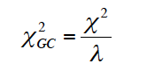
Genomic Control
Addresses the variance inflation problem
Empirically estimates the variance in the test statistics computed at null markers.
A variance inflation factor, lambda, is calculated based on the ratio of the empirical variance at null loci to the theoretical variance
This inflation factor is used to adjust the variance at the marker loci of interest
Same adjustment at all markers
Commonly used adjustment method

Slide 42
STRUCTURE
Pritchard (2000)
Infer the latent population structure, perform a stratified analysis
Needs the availability of AIMs (ancestry informative markers), markers that exhibit substantially different frequencies between populations from different geographical regions.
STRUCTURE uses a Bayesian clustering approach applying Markov Chain Monte Carlo (MCMC) estimation.
Start by randomly assigning individuals to a pre-determined number of groups, then variant frequencies are estimated in each group and individuals re-assigned based on those frequency estimates.
Repeat many times, until a progressive convergence toward reliable allele frequency estimates in each population and membership probabilities of individuals to a population.
Model-based, requires strong population-admixture (from a few distinct ethnicities) or the use of a large number of AIMs (ancestry informative markers)
Works well if model is estimated correctly, and if distinct populations present

Slide 43
Principal Component approach (Eigenstrat)
AIMs: Markers or group of markers that are surrogates for ancestry can be used as covariates in a regression analysis
Disadvantage: such ancestry informative markers need to be known in advance
With the arrival of genome-wide data such AIMs are not needed.
Instead, one can include null markers or linear combinations of null markers as covariates in the analysis (using linear or logistic regression). These linear combinations serve as surrogates of the underlying strata
Perform PCA (principal component analysis) on the variance-covariance matrix of all genotypes.
Select top K eigenvalues that are statistically significant
Include the significant eigenvectors in the regression of phenotype on marker

Slide 44
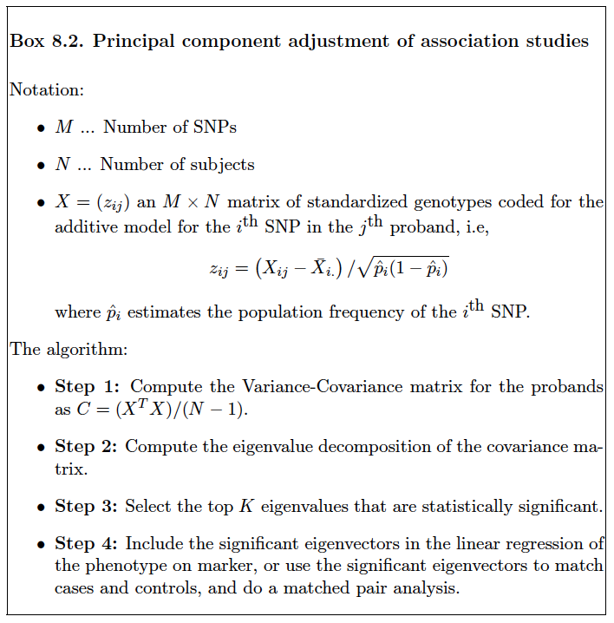

Slide 45
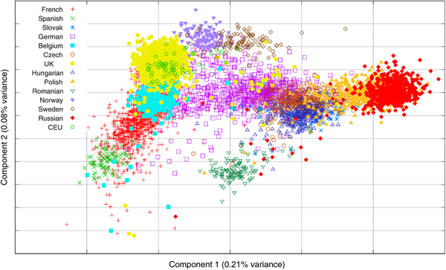

Slide 46
Mixed models
Mixed models can model population structure, family structure and cryptic relatedness
Model phenotypes using a mixture of fixed effects (SNPs) and random effects (family structure)
A new approach EMMAX (2010) is based on mixed-effects model to account for hidden relatedness

Slide 47
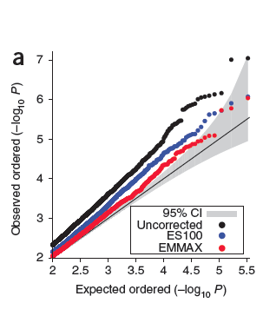
Under the null hypothesis of no association at any of the markers, the P-values follow a uniform distribution.

Slide 48
Family based association tests
Family-based tests are robust to population substructure
This robustness comes at a price.
They tend to have reduced power compared to population-based tests
Furthermore, family-based datasets are more difficult to collect

Slide 49
Association Analysis in family-based designs
Family-based studies have long history in genetics for association, as well as linkage and segregation
Example: compare the genotypes in cases with genotypes in their unaffected sibling
Unaffected sibling=control=> no confounding due to population stratification
When rejecting H0: no association implies more than association. It implies LD (marker is both associated and linked to disease).

Slide 50
The trio design and TDT
Affected offspring and biological parents
Three genotypes compared to two in a case-control design
It can be difficult to obtain parental genotypes for late-onset diseases, e.g., Alzheimer’s disease
Other designs: discordant sibships, trios with multiple affected siblings, multi-generational pedigrees.

Slide 51
TDT (transmission disequilibrium test)
Based on parental genotypes, using Mendel’s Laws of segregation we can get the distribution of the offspring genotype
Test is based on comparing the offspring genotypes to those expected based on parental genotypes
TDT is a test of both linkage and association
Therefore if either linkage or association is absent, the test has no power to reject

Slide 52
 |  | Untransmitted Parental Allele
Transmitted Parental Allele | A a | A a w x y z
Each parent has a transmitted allele and an untransmitted allele
w= #homozygous AA parents
z=#homozygous aa parents
w and z are not informative, i.e., we do not care about homozygous parents
x, y are important!
If no association, we have E[x]=E[y]
So conditioning on x+y, the count x is binomial with sample size x+y and probability
1/2
- Example: Spielman et al 1993
94 families, with two or more affected children with Insulin Dependent Diabetes
Mellitus
76 transmissions of allele 1 and 46 transmissions of allele 2 – highly significant

Slide 53
TDT vs. case-control
Power of TDT is expected to be lower than for case-control design with the same number of cases because, e.g., homozygous parents do not contribute
Also sample size is 3:2

Slide 54
FBAT
Originally, TDT limited to offspring and parents
Underlying disease model: additive
Many extensions to handle other genetic models, missing data etc.
FBAT is a unified family-based approach, an extension of TDT to: - missing parental genotypes, measured phenotypes, time-to-onset, different genetic models
www.biostat.harvard.edu/~fbat/fbat.htm

Slide 55
FBAT
Score statistic:
Center the offspring genotype by its expected value under the null to maintain robustness to pop stratification
If parental genotypes are missing can use genotypes of other relatives for the conditioning above

Slide 56
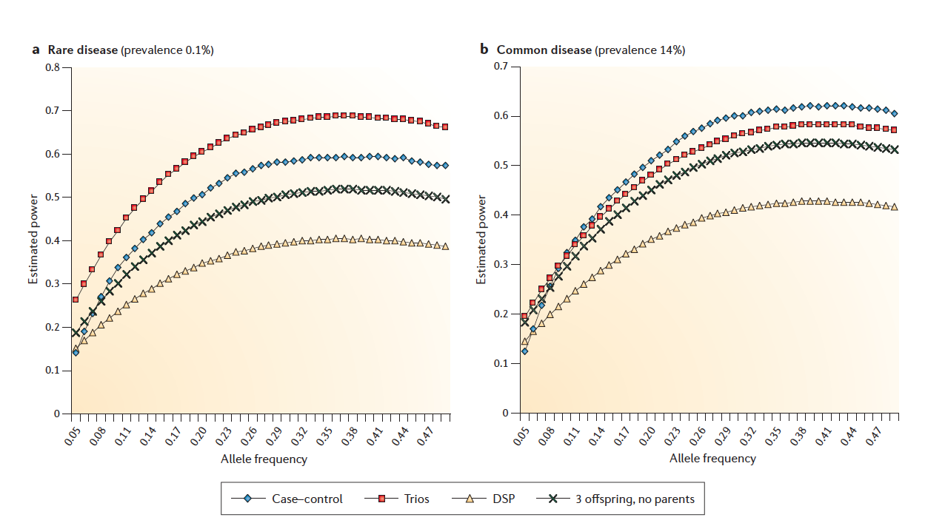
Power Comparison Family-based vs. Population-based Designs

Slide 57
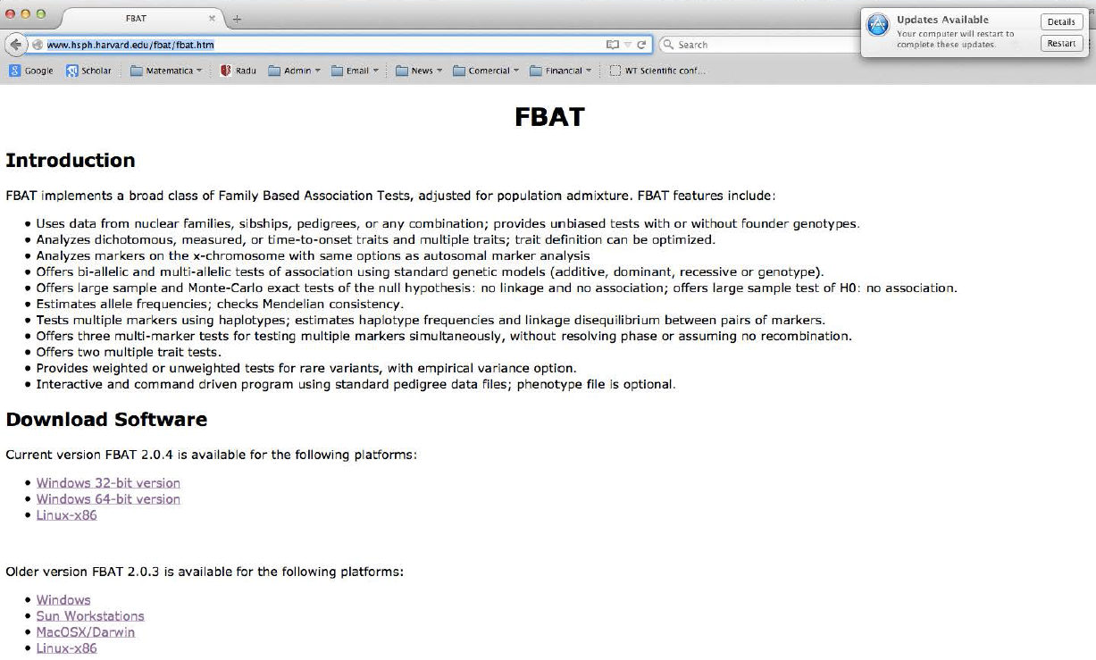

Slide 58
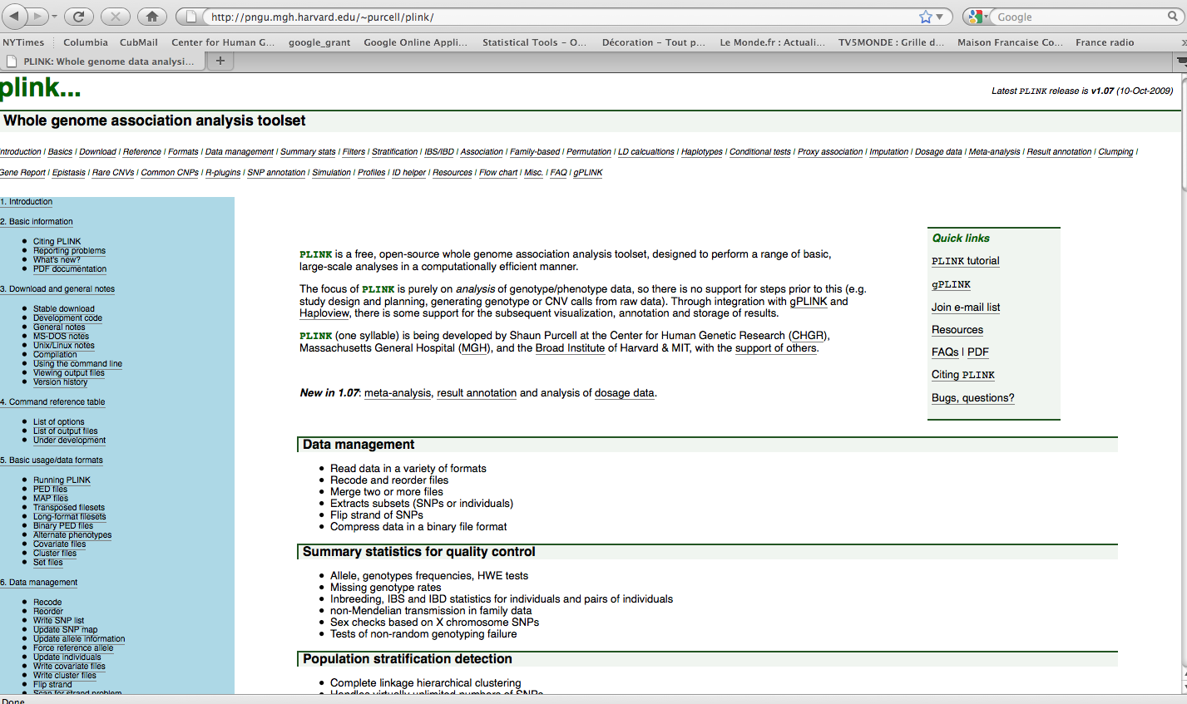

Slide 59
Power Calculations for Case-Control Designs
Many software packages to do power and sample size calculations
- PLINK (http://pngu.mgh.harvard.edu/~purcell/plink/)
- QUANTO (http://hydra.usc.edu/gxe/)
- CATS (two stage designs)
Need to specify: K=disease prevalence, frequency, relative risk, sample size.
Note that we usually may not have the true DSL, and we test for association with a marker in LD with the disease locus:
where is the correlation between marker and DSL.

Slide 60
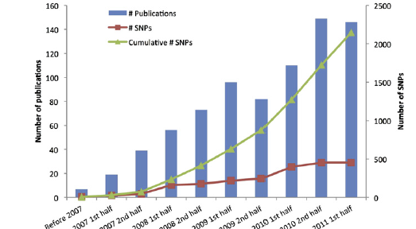

Slide 61
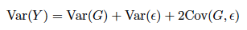
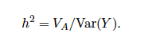
Heritability
The variance of the phenotype is partitioned into the genetic and non-genetic part
The proportion of phenotypic variance explained by additive genetic effects
The heritability estimate depends on disease allele frequency and on the strength of the environmental component, and hence can be population specific
GWAS hits explain only a small proportion of heritability
E.g. for type 2 diabetes, GWAS studies in > 150,000 individuals identified > 70 loci that explain ~11% of T2D heritability

Slide 62
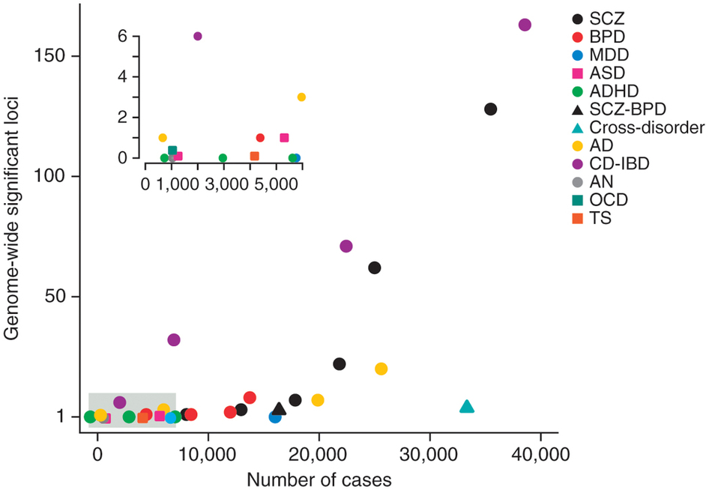
GWAS results for Psychiatric traits

Slide 63
Beyond GWAS: from GWAS signal to causal variant/gene
With a few exceptions, once a genome-wide association signal is identified, the causal variant (and gene) is unknown.
Much (fine-mapping) work remains to be done after a successful GWA study in order to identify the true culprit.
In addition to a statistical association identified based on contrasting case-control frequencies, additional information on the predicted functional impact of a variant needs to be incorporated into the model in order to identify the causal variants.

Slide 64
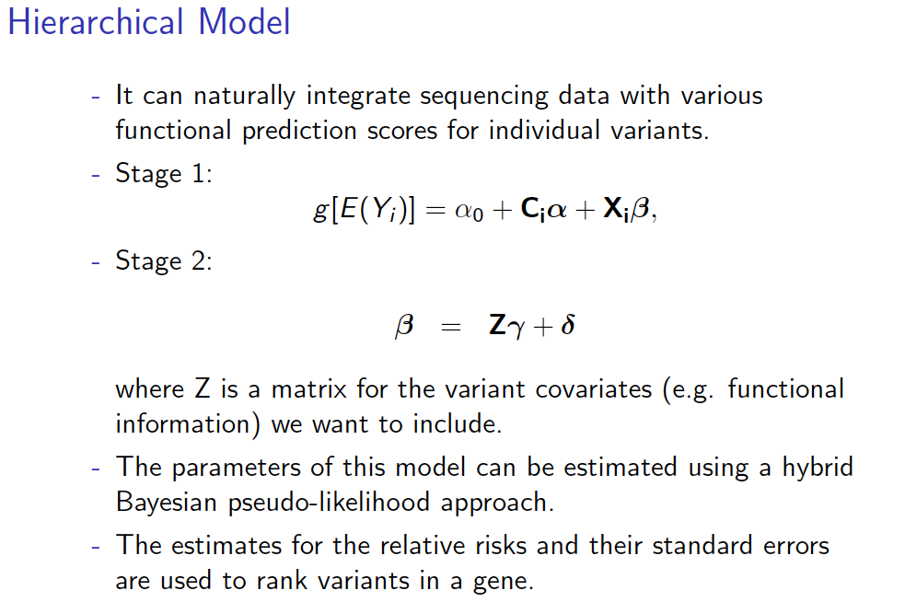

Slide 65
Hierarchical Model
With this hierarchical model, for each variant we get an estimate of effect size that takes into account both the allele frequencies in cases and controls, but also additional functional covariate information.
Hence variants with both strong statistical support and functional evidence are prioritized for experimental functional studies.

